Slide 1
Knowledge-in-Context：Towards Knowledgeable Semi-Parametric Language Models
顾轶洋 51255901083

Slide 2
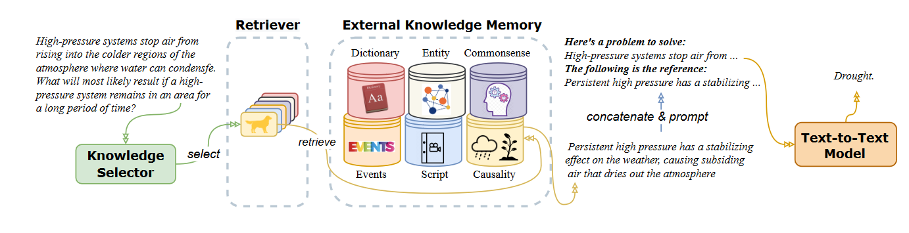
Introduction
Knowledge-in-context Language Model
有用的知识片段分布稀疏
很难检索正确知识
不确定是否包含所有需要的信息
生成式模型（T5）
外部知识+检索器
知识选择器
动机
组成

Slide 3
Knowledge
External Knowledge Memory and Retriever
Dictionary
Event
definitions and example sentences of English words.
<“apple”, definition, “A common, round fruit ...” >
knowledge about daily events with human-constructed.
ATOMIC, ASER
< “I am hungry”, before, “I eat food” >
Entity
Script
named entity knowledge in Wikipedia and Wikidata.
< “United States”, capital, “Washington D.C.” >
< “United States”, context, “It consists of 50 states ...” >
script knowledge
< verbal information, context, nonverbal information >
verbal info is an utterance, nonverbal info can be body move, vocal tones
Commonsense
Causality
commonsense knowledge from ConceptNet
<“bird”, CapableOf, “fly”>
auto-extracted causal knowledge CausalBank
< “babies cry”, therefore-mode, “will lead to sleep problems” >

Slide 4
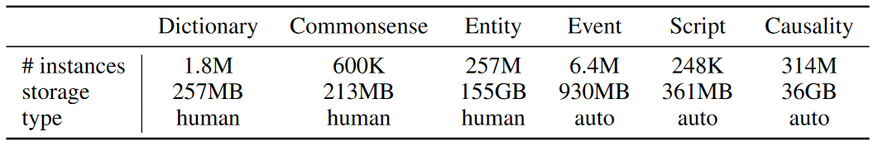
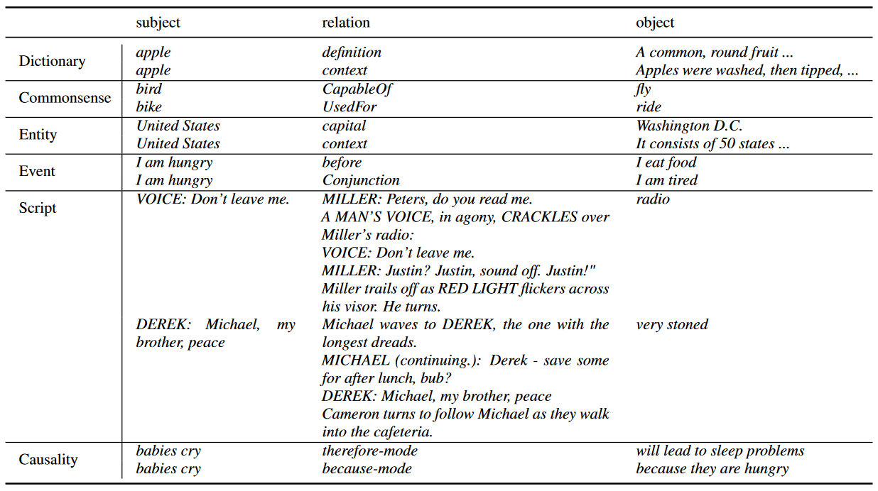
Knowledge
External Knowledge Memory and Retriever

Slide 5
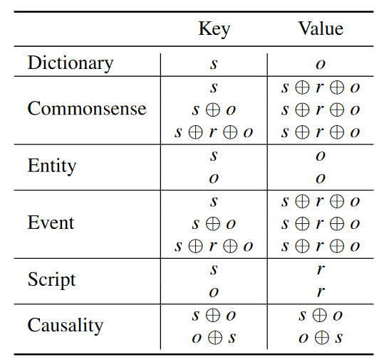
Knowledge
External Knowledge Memory and Retriever
Retriever
generate key-value pairs from the original knowledge pieces
encode all keys into dense vectors using a SOTA sentence encoder MPNet（All-MPNetbase-v2）
retrieve the most relevant knowledge using the maximum inner product search (MIPS)
KiC employ SCaNN as the MIPS search algorithm.

Slide 6
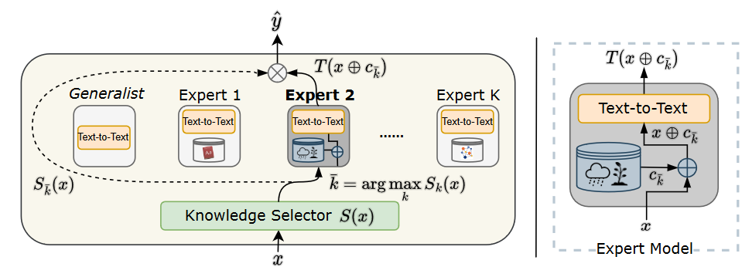
Model
KiC: A Mixture of Semi-Parametric Experts
KiC model utilizes a mixture-of-experts (MOE) architecture, with a knowledge selector acting as a router.
Each expert in the KiC model is a (shared) text-to-text model + knowledge base.
The KiC model includes a generalist module for conversations that do not require specific knowledge.

Slide 7
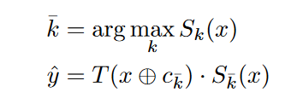
Model
KiC: A Mixture of Semi-Parametric Experts
Method
Sk(x)：知识选择器，K+1分类器（ k=0：无外部知识）
ck：知识检索结果

Slide 8
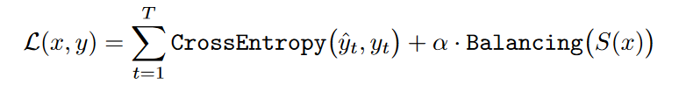
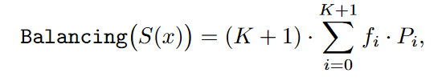
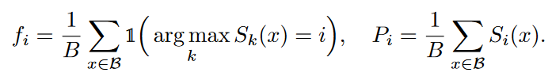
Model
KiC: A Mixture of Semi-Parametric Experts
Loss Function
Balancing Function
Si(x)：序列x分配给专家i的概率
Pi：批次B中所有序列分配给专家i的概率
fi：如果专家是i则为1，否则为0
可以鼓励均衡的专家选择分布，不要都倾向于选择同一个专家（switch transformer）

Slide 9
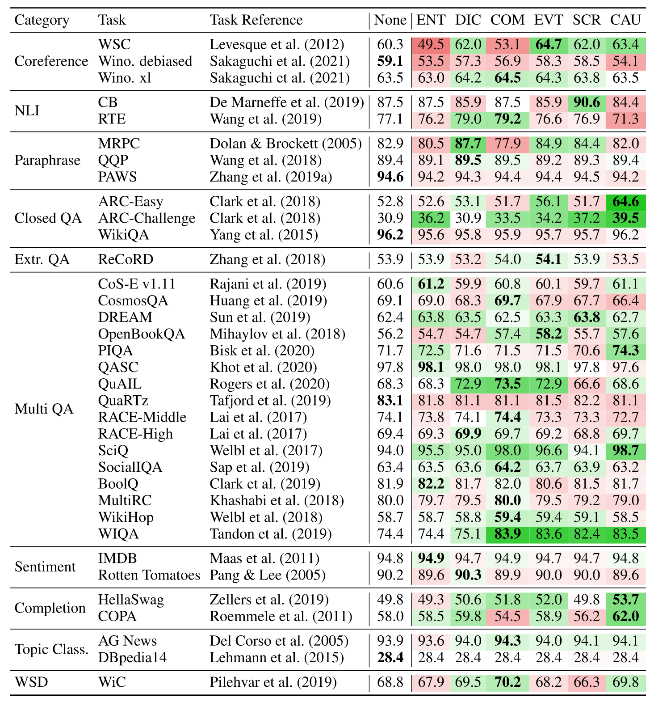
Experiments
Analysis of Knowledge Usefulness
Single task fine-tuning results (accuracy %) of using no knowledge (None) or adding entity (ENT), dictionary (DIC), commonsense (COM), event (EVT), script (SCR), or causality (CAU) knowledge separately.
All results in this table are based on T5Base.

Slide 10
Experiments
Analysis of Knowledge Usefulness

Slide 11
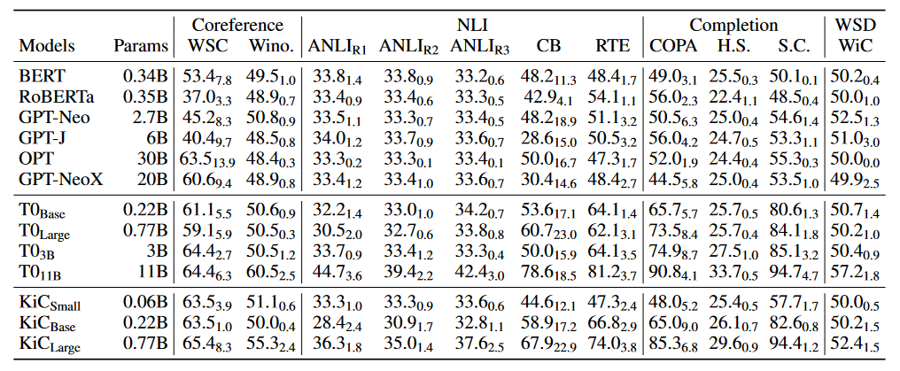
Results
Zero-shot generalization
Zero-shot evaluation results on held-out unseen tasks.
report the median accuracy (%) and the standard deviation of all prompts used.
T0Base and T0Large are reproduced using the same collection of tasks and hyper-parameters with KiC.

Slide 12
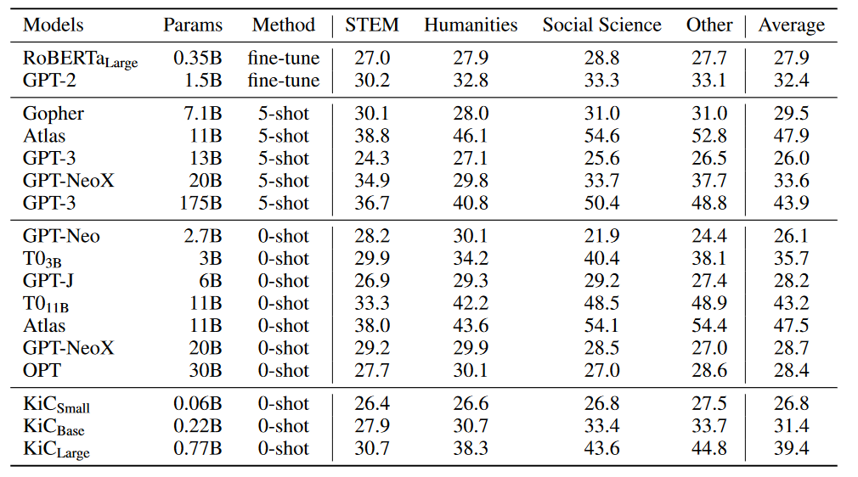
Results
MMLU tasks
Comparison to state-of-the-art results on the test set of MMLU tasks.
Use the prompt that yields the best accuracy (%) on the validation set.

Slide 13
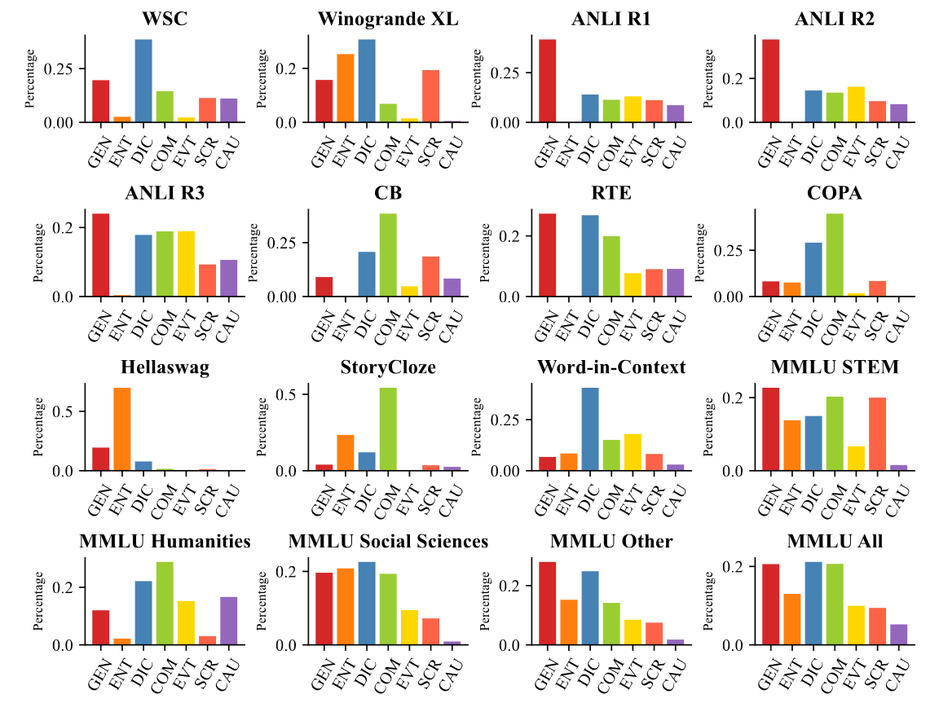
Results
MMLU：Usage of knowledge

Slide 14
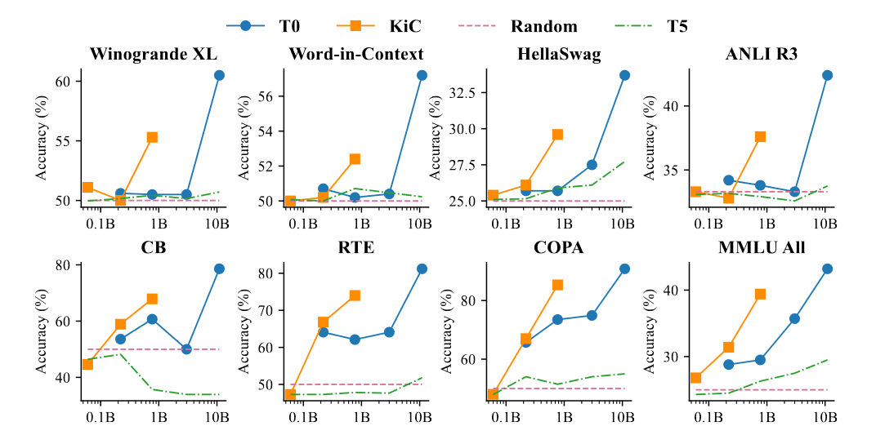
Results
Emerging behavior
Emerging behaviors of T5, T0 and KiC models. KiC model shows emerging behavior at a much smaller model scale (when it increases from 0.22B to 0.77B) compared to T0.

Slide 15
Thank You
顾轶洋 51255901083

